Slide 1

Used Car Price Prediction
By: Joshua Jonathan
Internship 31
SME: Gulshana Chaudhary

Slide 2

Agenda:
Introduction
Problem Statement
Problem Understanding
What Is a Used Car Price?
Benefits of Buying Used Car
Importance of Used Cars
Data Analysis & Model Building Flowchart
Exploratory Data Analysis Steps
Visualizations: Univariate and Bivariate
Data Analysis Steps Done
Assumptions
Model Building
Hyper Parameter Tuning and Crating Final Model
Saving the model and prediction results
Conclusion

Slide 3

Introduction:
Predicting the price of used cars is an important and interesting problem. Predicting the resale value of a car is not a simple task. It is trite knowledge that the value of used cars depends on several factors.
The most important factors are usually the age of the car, its make (model), the origin of the car (the original location of the manufacturer), its mileage (the number of kilometres it has run), and its horsepower (amount of power that an engine produces).
Due to rising fuel prices, fuel economy is also of prime importance. Unfortunately, in practice, most people do not know exactly how much fuel their car consumes for each km driven. Other factors such as the type of fuel it uses, the interior style, the braking system, engine displacement, its size, number of doors, paint colour, the weight of the car, consumer reviews, its physical state, and whether it is automatic or manual transmission, whether it belonged to an individual or a company and other options such as air conditioner, sound system, power steering all may influence the price as well.
Some special factors buyers attach importance to are the location of previous owners, and whether the car had been involved in serious accidents. The look and feel of the car certainly contribute a lot to the price. As we can see, the price depends on a large number of factors. Unfortunately, information about all these factors is not always available and the buyer must decide to purchase at a certain price based on a few factors only. We have considered only a small subset of the more important factors in this work.

Slide 4

Problem Statement
Problem Understanding
With the covid 19 impact on the market, we have seen a lot of changes in the car market. Now some cars are in demand hence making them costly and some are not in demand hence cheaper. One of our clients works with small traders, who sell used cars. With the change in the market due to covid 19 impact, our client is facing problems with their previous car price valuation machine learning models. So, they are looking for new machine learning models from new data. We have to make a car price valuation model.
Business goal: The main aim of this project is to predict the price of a used car based on various features. Machine Learning is a field of technology development with immense abilities and applications in automating tasks. So, we will deploy an ML model for car selling price prediction and analysis. This kind of system becomes handy for many people. This model will provide the approximate selling price for the car based on different features like fuel type, transmission, price, weight, running in km, engine displacement, milage, etc and this model will help the client to understand the price of the used cars.
Car Price Prediction is an interesting machine learning problem as many factors influence the price of a car in the second-hand market. Here we are trying to help the client works with small traders, who sell used cars to understand the price of the used cars by deploying machine learning models. These models would help the client/sellers to understand the used car market and accordingly they would be able to sell the used car in the market.
From the problem statement we came to know that it is a regression type problem since our target variable “Car price” is continuous hence we need to build regression algorithms to predict the price of used cars.

Slide 5

What is Used Car Price?
A used car, a pre-owned vehicle, or a second-hand car, is a vehicle that has previously had one or more retail owners. Used cars are sold through a variety of outlets, including rental car companies, independent car dealers, buy here pay dealerships, leasing offices, auctions, and private party sales. Used car pricing reports typically produce three forms of pricing information.
Dealer or retail price is the price expected to pay if buying from a licensed new-car or used-car dealer.
Dealer trade-in price or wholesale price is the price a shopper should expect to receive from a dealer if trading in a car. This is also the price that a dealer will typically pay for a car at a dealer wholesale auction.
Private-party price is the price expected to pay if buying from an individual. A private-party seller is hoping to get more money than they would with a trade-in to a dealer. A private-party buyer is hoping to pay less than the dealer’s retail price.
Benefits of Buying Used Cars:
Save Money
Used Cars Have The Features That You Want
Lower Insurance Rates
Good Condition
Falling Registration Fees
Depreciation Advantages
Vehicle History Reports Make Used Purchases Less Risky
Used Cars Have Rich Aftermarket Communities
The Ideal Starting Partner
Used Cars Are Just As Capable As New Cars

Slide 6

Importance of Used Cars:
There are certain things that will tell you the importance of buying a used car rather than a new car, they are as follows:
Experts say when a new car leaves the lot, its value gets depreciated by less than or equal to 10% of the original price for which it is bought. The value gradually gets depreciated every month and year. But in the case of a used car, the depreciation has already occurred a lot of times. Amazingly, some may have got its value increased too.
The price of a new car will usually be high. Also a lot amount of rupees that are hidden from you such as for shipping purposes will be charged extra. But in the case of used cars, there are no such extra fees charged. But a few hundred rupees will somehow be charged for the documentation fee.
A used car need not be added with extra fittings which are always expensive when it has to be installed in a new car. For a used car you can add extra fittings of your own preference with a low budget. This will help you save money.
The pre-owned cars are checked for repairs and get refurbished. Certification is provided to ensure the vehicle is of good quality after a complete inspection is done.
The emission of carbon dioxide from vehicles is dangerous to our environment. A new car will tend to emit more of this gas from manufacturing till its last usage. So if you are buying a used car, then the emission during its manufacture is reduced which is good for our surroundings.

Slide 7
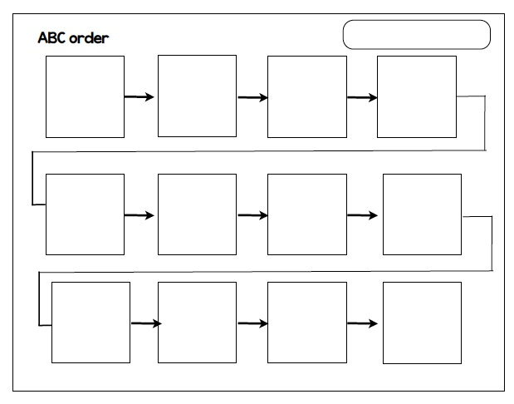
Finding
and
Treating
Null Values
Import
Collected
Dataset
Data
Pre
processing
Import
Libraries
Identifying
Outliers
and
Skewness
Checking
Correlation
and
VIF
Data
Visualization
(EDA)
Label
Encoder
R2 score,
CV &
Evaluation
Metrics
Hyper
Parameter
Tuning
Saving the
Model &
Predictions
Model
Building

Slide 8

Exploratory Data Analysis (EDA) Steps
Importing necessary libraries and importing datasets as a data frame.
Checked some statistical information like shape, number of unique values present, info, data types, etc.
From the dataset I found some numerical features having “-“ sign and string values like “null” so I replaced them with NAN values and dropped the columns having more than 50% of “-“ sign as they were of no use for prediction.
Done feature engineering on some features as they had some irrelevant values and replaced them with appropriate values.
Extracted the features Brand, Model, and Manufacturing_year from the column Car_Name and created Car_age by subtracting the Manufacturing year of the car from the year 2021.
Converted all the numerical continuous columns from object data type into float data type after cleaning the data.
Checked for null values and treated them using imputation techniques like mean, median, and mode methods. Checked the statistical summary of the dataset using describe () method.
Visualizing the features using univariate, bivariate, and multivariate analysis. Visualized each feature using seaborn and matplotlib libraries by plotting several categorical and numerical plots like pie plots, count plots, bar plots, reg plots, strip plots, line plots, violin plots, distribution plots, box plots, and pair plots.
Identified outliers using box plots and removed outliers in continuous numerical columns using Zscore.
Checked for skewness and removed skewness in numerical columns using the power transformation method (yeo-johnson).
Used Pearson’s correlation coefficient to check the correlation between labels and features. With the help of a heatmap and correlation bar graph was able to understand the Feature vs Label relativity and insights on multicollinearity amongst the feature columns.

Slide 9

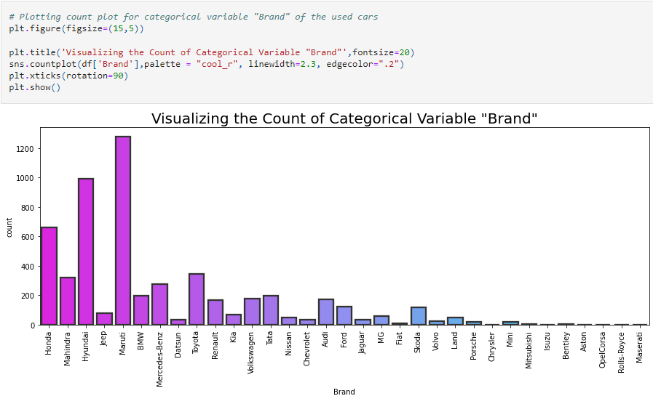
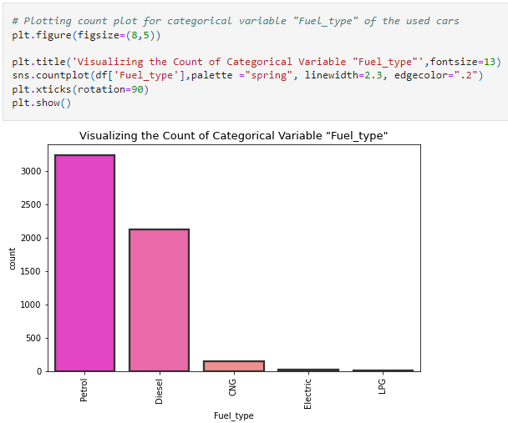
Visualization :Univariate Analysis
Observations:
The above count plot gives the count of cars' brand. From the graph we can conclude that we are having most of the cars from Maruti and Hyundai brand as the count is high for these brands.
Observations:
The above plot gives the count of fuel types used by the cars. More number of cars are using petrol followed by diesel as fuel. And very few cars uses CNG, LPG and Electricity as fuel type.

Slide 10

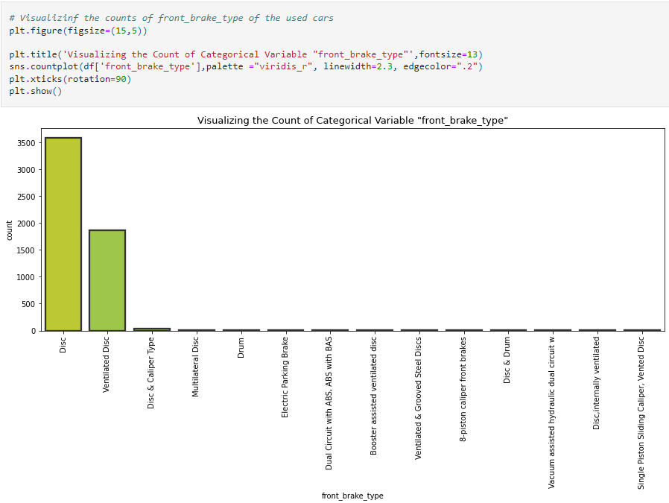
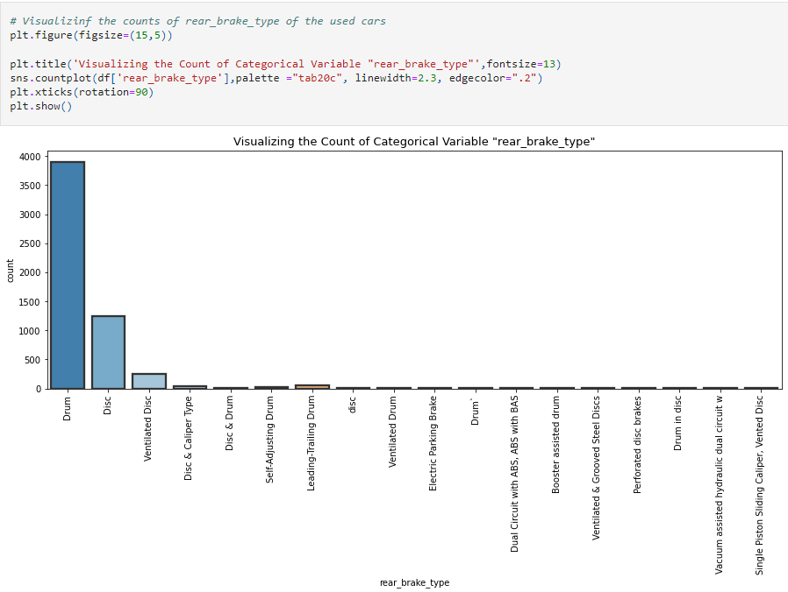
Visualizing Counts of Categorical Variables
By visualizing the above count plot we can conclude that the cars with Disc and Ventilated Disc type of brake system used for front-side wheels are having high count compared to other brake types.
The above graph represents the count of rear_brake_type of the cars which shows that the cars having Drum type of brake system used for back-side wheels are having high count of around 10000 compared to other type of rear brakes.

Slide 11

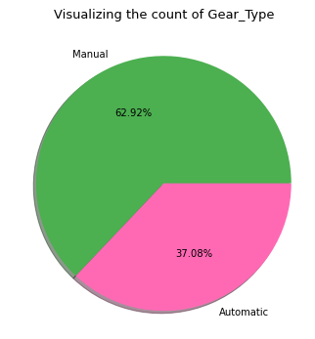
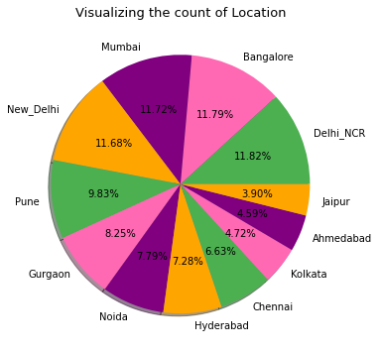
The plot gives the count of transmission, from this graph we can notice that around 63% of the cars are with Manual gear transmission system and only 37% of the cars are with Automatic gear transmission system.
By looking at the above count plot we can get to know that the cars from the city Delhi_NCR, Bangalore, Mumbai and New_Delhi have high counts which are almost similar. And the other locations also have no much difference in the counts.

Slide 12

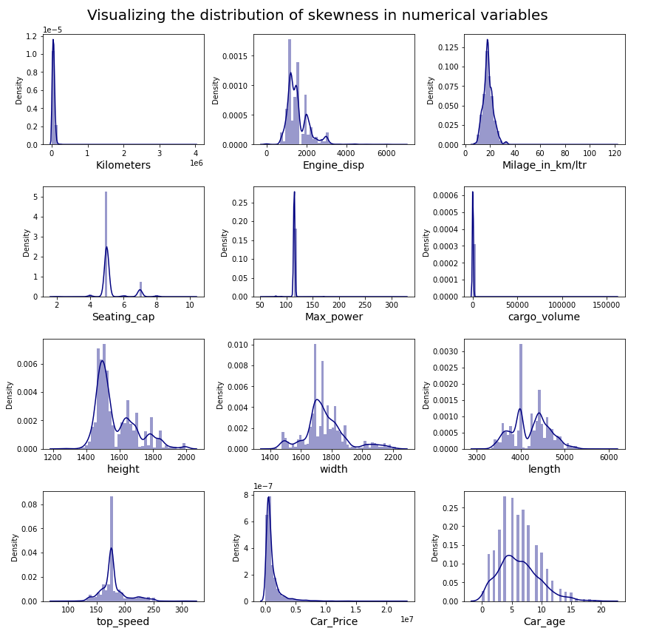
Distribution of skewness Plotting Numerical Variables
The distribution plot shows how the data has been distributed in each of the columns.
From the distribution plots we can observe most of the columns are not normally distributed, only the columns "Milage_in_km/ltr" look somewhat normal.
Also, we can notice the columns like "Running_in_kms","Engine_disp","Max_power","Weight","Carage" etc are skewed to right as the mean value in these columns are much greater than the median (50%).
The data in the column "height" skewed to the left since the mean value is less than the median.

Slide 13

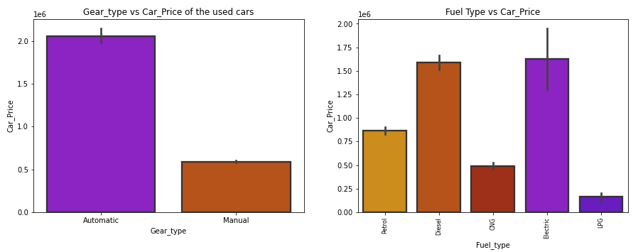
Car_Price vs Gear_type: From the bar plot we can observe that the cars which have Automatic gear system are having high price compared to the cars which have Manual gear system. Car_Price vs Fuel Type: From the second plot we came to know that the Electric and diesel cars have higher price compared to other models
Bivariate Analysis: Visualizing Categorical Variables vs Label

Slide 14

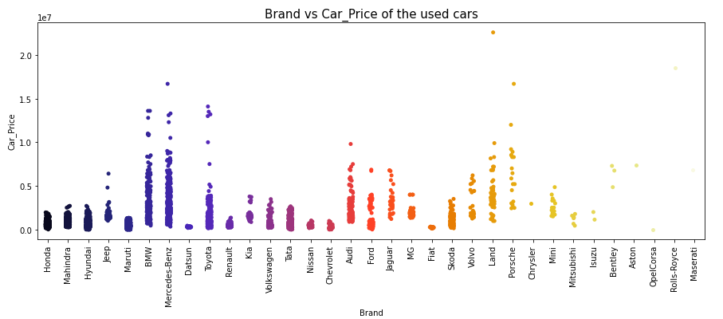
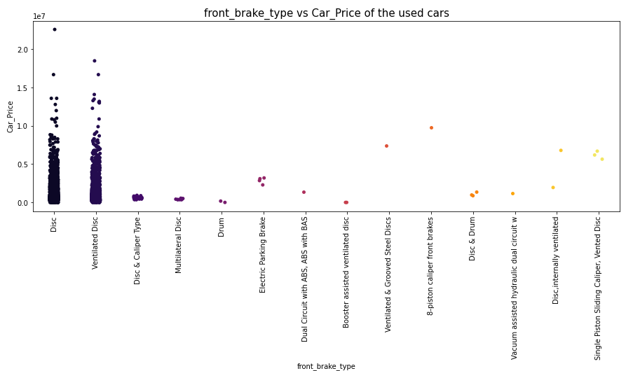
Car_Price vs front_brake_type : Looking at the above bar plot for front_brake_type vs Car_Price we can say that the cars with Disc and Ventilated Disc system for front wheels are having higher prices than other type of braking systems.
Car_Price vs rear_brake_type: The above graph is representing a bar plot for rear_brake_type vs Car_Price which tells us that the cars having Ventilated Disc or Disc or Drum brake system are having higher prices than the cars with other type of braking system at rear side.

Slide 15

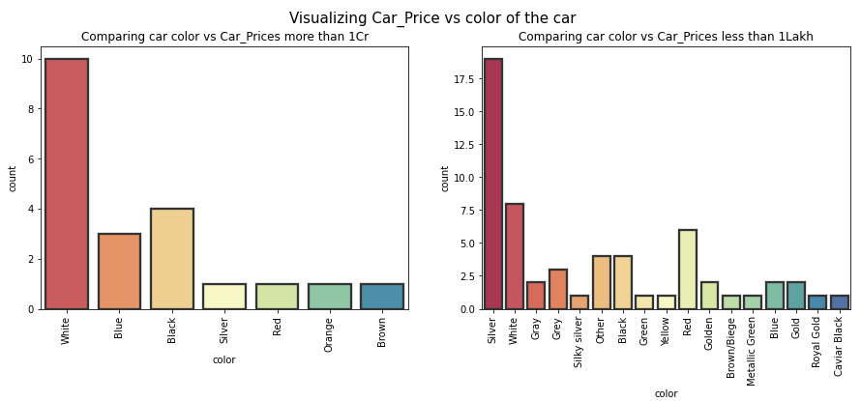
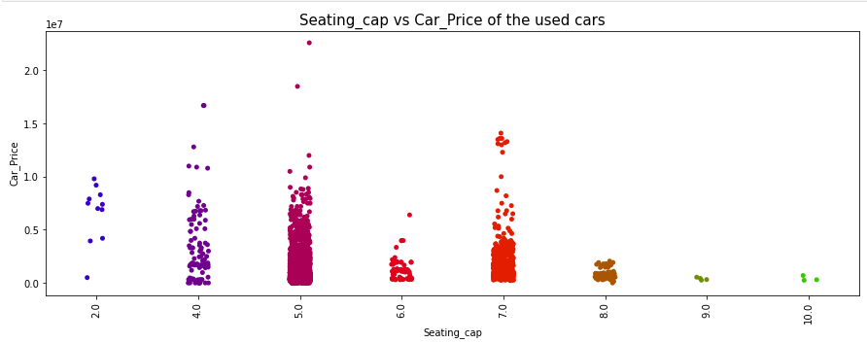
Car_Price vs color: The first count plot is for the car color vs Car_Prices more than 1 Cr. The plot shows the colors of expensive cars. The white color cars are more expensive compared to the cars with other colors.
The second graph is for the car color vs car prices below 1 Lakh and it shows the colors of cars which are cheap. From the plot we can say the cars with Silver color and white color have less price.
Car_Price vs Seating_cap: Most of the cars have seating capacity of 5, 7 and 4 and these cars having higher prices than other cars. And only 3 cars are observed with the seating capacity of 10.

Slide 16

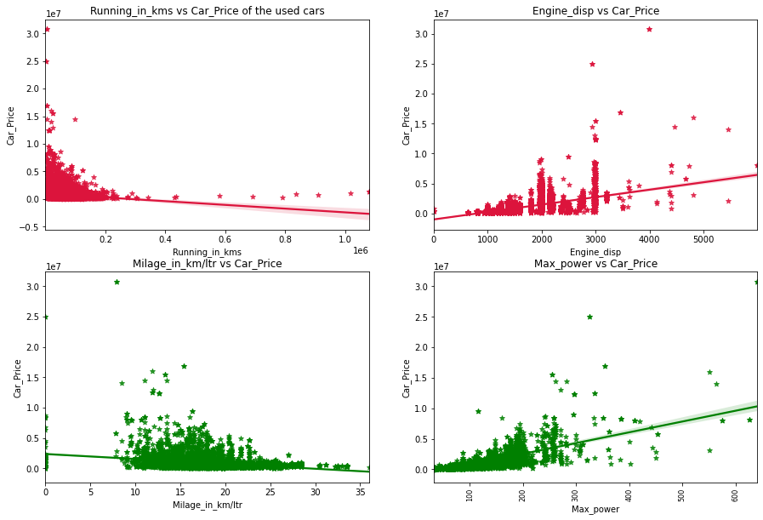
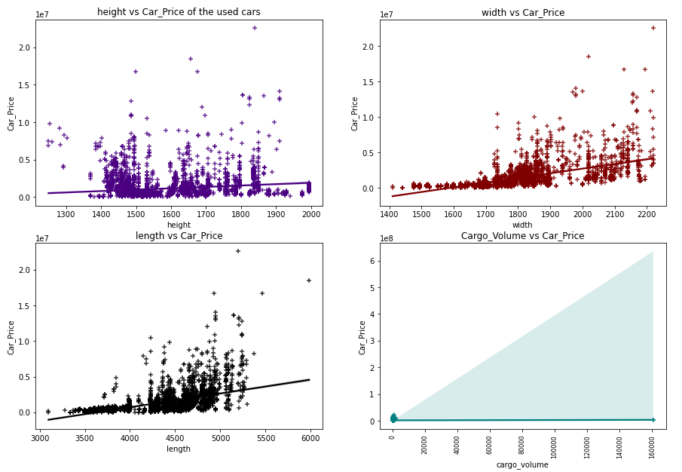
Car_Price vs Running_in_kms: From the plot, we can say that the prices of cars are higher for the cars which have less running in km. We can also notice there is a negative linear relationship between the price and the running of cars.
Car_Price vs Engine_disp: There is a positive correlation between car price and engine displacement. So, we can say as the engine disp or engine cc increases, the price of the car also increases.
Car_Price vs Milage_in_km/ltr: The cars having mileage in the range of 10 to 20 km/ltr are having high sale prices. From the graph, we can also notice there is a negative linear/correlation between the price and milage also some used cars have 0 milage which is unrealistic.
Car_Price vs Max_power: Looking at the graph we can say there is a positive correlation between car price and maximum engine power so, we can say as the maximum power engine increases, the car prices also go on increasing.
Car_Price vs height: From the graph, it is clear that the car price is not strongly related to the height of the car, we can say the cars having a height in the range of 1300 mm to 1800 mm have somewhat high prices.
Car_Price vs width: The graph shows there is some positive linear relation between car price and width of the car, so the cars having a width in the range of 1700mm to 2200mm have a high price. So, we can conclude as the width of the car increases, the price of the car also goes on increasing.
Car_Price vs length: There is some positive linear relation between car price and length of the cars. As the length of the cars increases, the price of the cars also increases. The cars that are having a length above 4250mm have high prices.
Car_Price vs Weight: There is some positive linear relationship between the price of the car and weight. The cars with a weight of 1500kg have a high price.

Slide 17

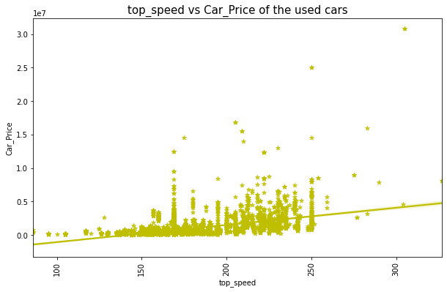
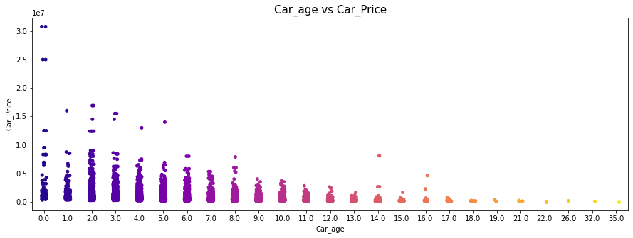
Car_Price vs top_speed: From the graph, we can notice there is a positive linear relation between car price and the maximum speed limit of the car. The cars that had a top speed in the range of 120 km/hr to 250 km/hr have a higher price and there is a very less number of cars that have a top speed below 100km/hr. So, we can conclude that as the maximum speed limit of the car (top_speed) increases, the car price also increases.
Car_Price vs Car_age: From the above strip plot we can say that the older cars are having very lower prices when compared to the new cars which are the cars having very less age. So, there is a negative relation between car price and the age of the cars and we can conclude as the age decreases, the car prices increase.

Slide 18

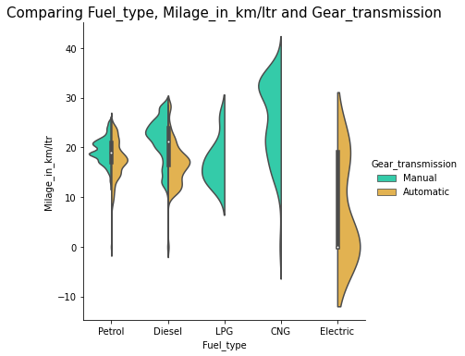
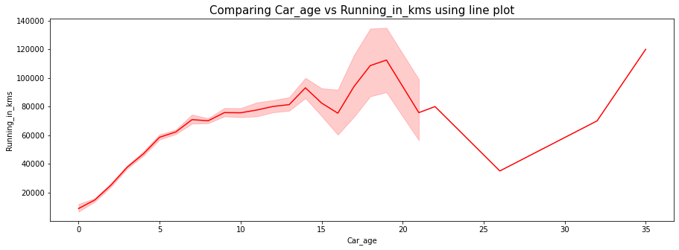
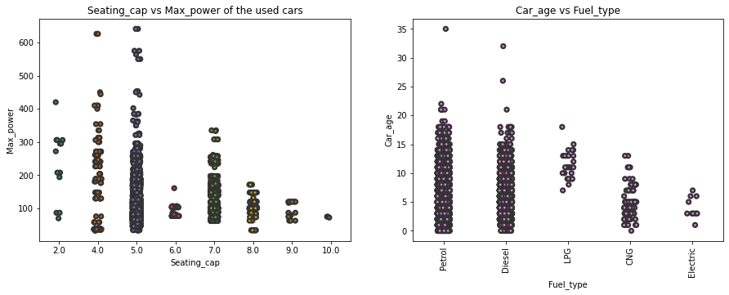
Fuel_type vs Milage_in_km/ltr: The violin plot gives the relation between Milage in km/ltr and Fuel type based on gear transmission. As we can observe the cars with Manual gear transmissions which are using CNG as fuel are having good mileage compared to other fuel types.
Car_age vs Running_in_kms: The above graph represents car_age vs Running in km. The cars which have their age from 2 years to 16 years have highly used. That is the running kits for these cars are around 1 lakh km.
Seating_cap vs Max_power: The cars with a seating capacity of 5 have a high maximum power of engine used in cars and the cars with a 10 seating capacity have very less maximum engine power.
Fuel_type vs Car_age: The cars which are using Patrol and Diesel as the fuel have high age and the cars with low age are using electricity as the fuel.

Slide 19

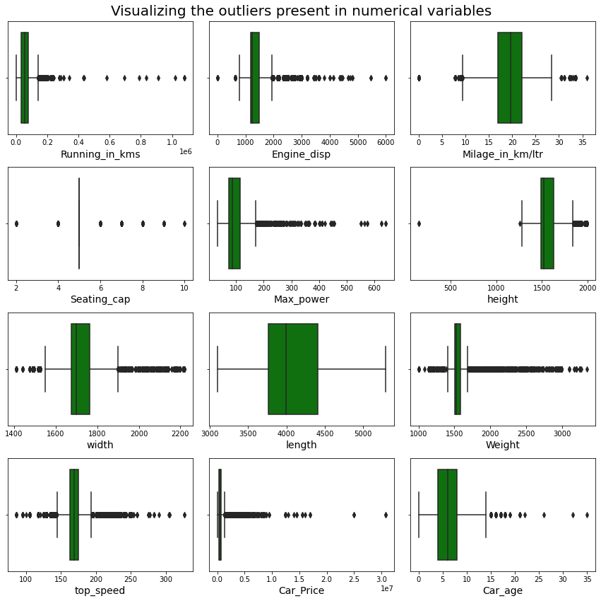
Identifying the outliers using box plot
A box plot is used to summarize data sets by using the box and whisker plot method. This function helps to understand the data summary properly. Box plots can be very useful when we want to know how the data is distributed and spread. Three types of quartiles are used in the box plot to plot the data. These values include the median, maximum, minimum, upper-quartile, and lower-quartile statistical values. A box plot summarizes this data in the 25th, 50th, and 75th percentiles.
From the box plot we can notice the outliers present in all the features except the length column. I have removed the outliers using the Zscore method except for length and Car_Price. Since Car_Price is our target column we should not lose any data by removing outliers in this column.

Slide 20

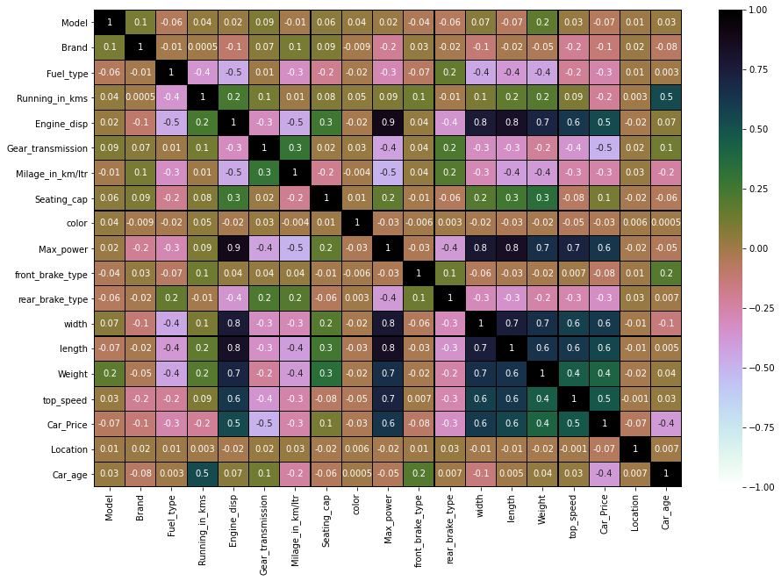
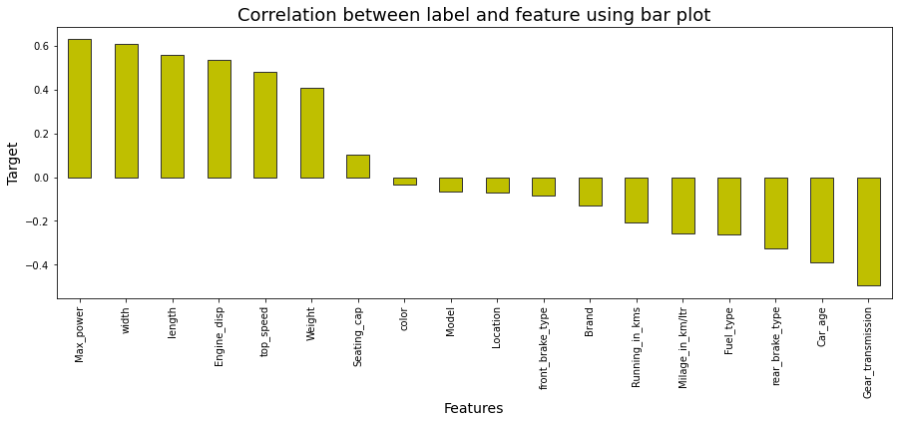
Correlation Between Features and Label
From the heat map and bar plot we can observe the positive and negative correlation between the label and features. From the heat map, we can notice that the dark shades are highly positively correlated and light shades are highly negatively correlated with the target variable.
We can observe from the map that most of the columns are highly correlated with each other which leads to a multicollinearity problem. So, I checked the VIF value and removed the columns having high VIF values to overcome this multicollinearity problem.

Slide 21

Data Analysis Steps:
I have done feature engineering steps like feature extraction and feature selection to improve data normality and linearity.
Identified outliers using boxplots and removed outliers using the Zscore method.
Identified skewness using distribution plots and removed skewness using the power transformation method (yeo-johnson method).
Used Pearson’s correlation coefficient to check the correlation between dependent and independent variables. To visualize the correlation I have used a heatmap and bar plot. Checked for VIF and solved multicollinearity problem.
I have used the Standard Scalar method to scale the data to overcome the issue of data biases.
Split train and test to build machine learning models. Found the best random state and best accuracy. The model building process will be shown in further steps.
Assumptions:
Firstly, from the problem statement we got to know that it is a Regression type problem for which we used Regression algorithms to build the model and predicted the sale price of used cars by collecting the data from the card echo website using web scraping.
Secondly, from the distribution plots and box plots, I found skewness and outliers in almost all the columns. Also, based on the analysis and visualization part we have seen some of the features have a linear relation with the label. So, I assumed these features help in model building and to predict the sale price of the old cars. Also, this model helps the car-selling dealers/companies and buyers understand the feature price of the cars.
So, I suggest that the dealers and buyers consider this model the features that were deemed as most important as seen in this study might help them estimate the car price

Slide 22

Model Building:
In this problem Car_Price is our target variable which is continuous in nature where we need to predict the price of pre-owned cars. From this, I can conclude that it is a Regression type problem hence I have used the following regression algorithms.
After the pre-processing and data cleaning I left with 18 columns including the target and with the help of the feature importance bar graph I used these independent features for model building and prediction. The algorithms used in training the data are as follows:
Decision Tree Regressor
Random Forest Regressor
Extra Trees Regressor
Gradient Boosting Regressor
Extreme Gradient Boosting Regressor (XGB)
Bagging Regressor
Kneighbors Regressor
I have got the best random state and maximum R2 score and then created train test split to build the above models.

Slide 23

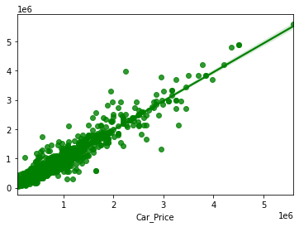
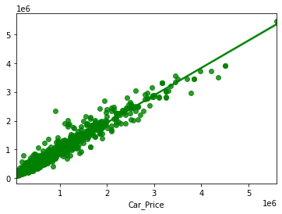
Decision Tree Regressor
Created the Decision Tree Regressor model and checked for its evaluation metrics. The model is giving an R2 score of 92.45%.
From the graph we can observe how our model is mapping. In the graph, we can observe the straight line which is our actual dataset and dots are the predictions that the model has given.
Random Forest Regressor:
Created Random Forest Regressor model and checked for it's evaluation metrics. The model is giving R2 score as 95.30%.
From the graph we can observe how our model is mapping. In the graph we can observe the straight line which is our actual dataset and dots are the predictions that our model has given.

Slide 24

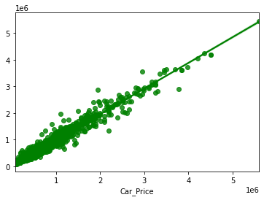
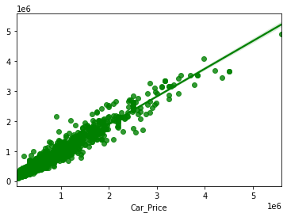
Extra Trees Regressor:
We have created the Extra Trees Regressor model and checked for its evaluation metrics. And the model is giving an R2 score of 94.04%.
From the graph we can observe how our model is mapping. In the graph, we can observe the straight line which is our actual dataset and dots are the predictions that our model has given.
Gradient Boosting Regressor:
Created Gradient Boosting Regressor model and checked for its evaluation metrics. The model is giving an R2 score of 93.36%.
From the graph we can observe how our model is mapping. In the graph, we can observe the straight line which is our actual dataset and the dots are the predictions that our model has given.

Slide 25


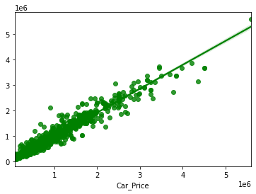
Extreme Gradient Boosting Regressor (XGB):
Created XGB Regressor model and checked for its evaluation metrics. The model is giving an R2 score of 94.72%.
From the graph we can observe how our model is mapping. In the graph, we can observe the straight line which is our actual dataset and the dots are the predictions that our model has given.
Bagging Regressor:
Created Bagging Regressor model and checked for its evaluation metrics. The model is giving R2 score as 93.96%.
From the graph we can observe how our model is mapping. In the graph we can observe the straight line which is our actual dataset and the dots are the predictions that our model has given.

Slide 26

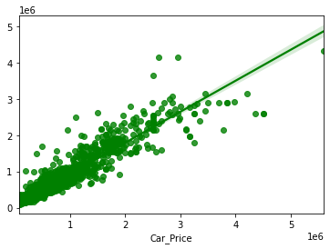
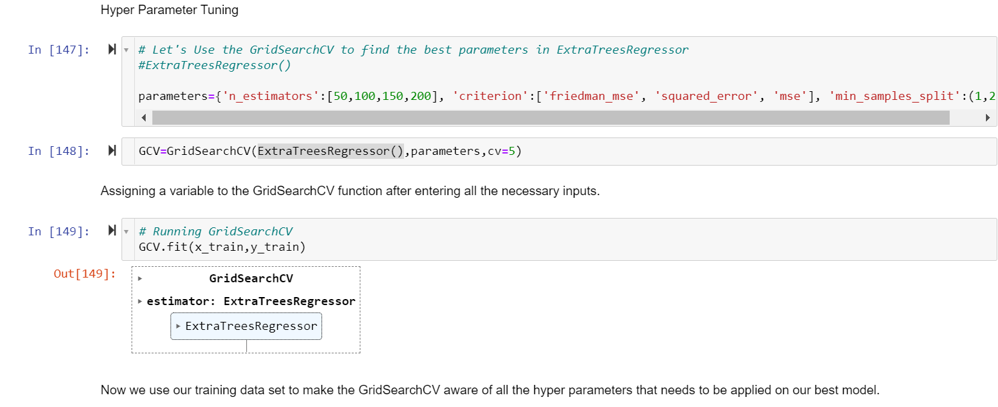
K Neighbors Regressor
Created the KNN Regressor model and checked for its evaluation metrics. The model is giving an R2 score of 87.39%.
From the graph we can observe how our model is mapping. In the graph, we can observe the straight line which is our actual dataset and the dots are the predictions that our model has given.
Hyper parameter Tuning:
From the difference between the R2 score and cross-validation score, we found that the “Extra Trees Regressor” has the least difference compared to other models. So, we concluded that the “Extra Trees Regressor” was our best fitting model. Performed Hyperparameter tuning to increase the best model accuracy.
I have used GridSearchCV to get the best parameters for Extra Trees Regressor . And used all the obtained best parameters to create the accuracy of the final model.

Slide 27

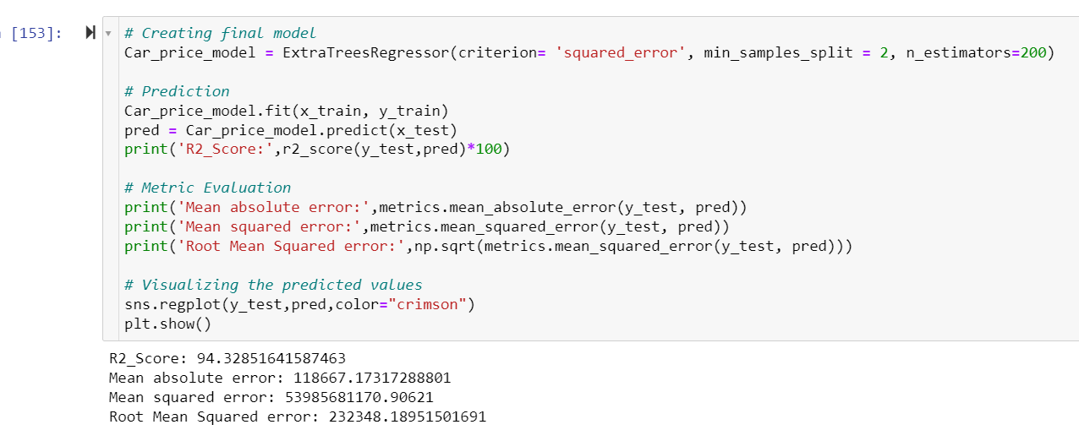
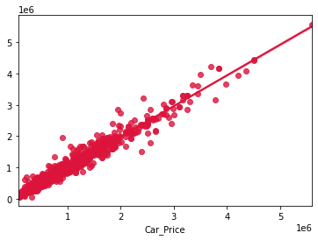
Creating Final Model After Tuning:
I have successfully incorporated the hyperparameter tuning using the best parameters of Extra Trees Regressorby using GridSearchCV and the R2 score of the model has been increased after hyperparameter tuning and received the R2 score as 94.32% which is very good.
From the graph we can observe how our final model is mapping. In the graph, we can observe the best fit line which is our actual dataset and the dots are the predictions that our best final model has given.

Slide 28

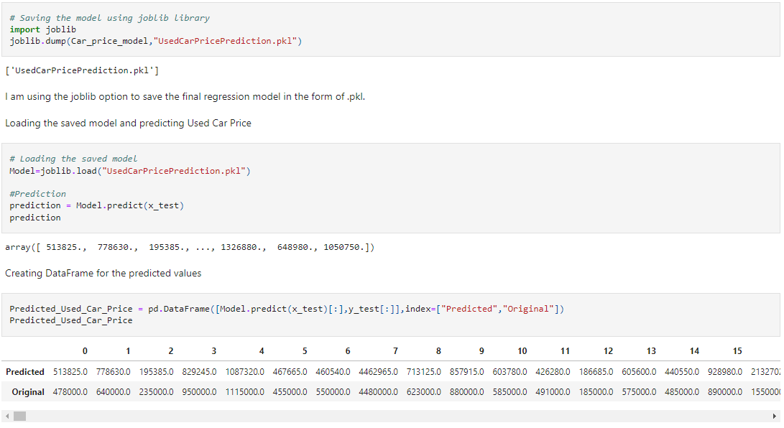
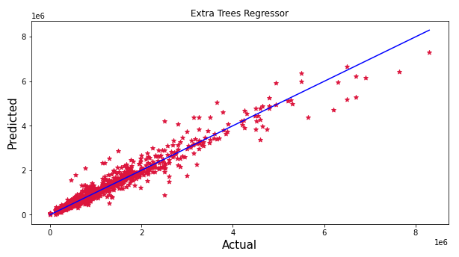
Saving The Final Model And Predictions From Saved Model
I have saved my final best model using the joblib library in .pkl format and loaded the saved model for predictions.
Using the regression model, we have got the predicted sale price of the cars. From the predictions, we can notice both actual values and predicted values are almost the same.
The graph shows how our final model is mapping. The plot gives the linear relation between the predicted and actual price of the used cars. The blue line is the best fitting line which gives the actual values/data and the red dots give the predicted values/data.

Slide 29

Conclusion:
The case study aims to give an idea of applying Machine Learning algorithms to predict the sale price of used cars. After the completion of this project, we got an insight into how to collect data, pre-process the data, analyze and clean the data and build a model.
First we collected the used car data from the website www.cardekho.com and it was done by using Web scraping using the framework Selenium, which has the advantage of automating our process of collecting data. We collected almost 12608 of data which contained the selling price of the used cars and other related features. Then, the scrapped data was saved in an excel file so that we can use it further and analyze the data.
Then we loaded the dataset and have done data cleaning, EDA process, and pre-processing techniques like checking outliers, skewness, correlation, scaling data, etc. and got better insights from data visualization.
From the visualizations we got to know that the continuous numerical variables have some positive linear relation with the “Car_Price”. By comparing car price and categorical variables we got to know that the cars having automatic gear transmission, cars from the city Bangalore, cars using petrol and diesel as fuels, cars having brands Benz and BMW, and cars with 5-7 seating capacity have a high sale price. While comparing continuous numerical variables and Car_Price we found that cars which are having good mileage, engine displacement, and less running in km have a good linear relationship with the price that is the cars with this kind of quality have high selling prices.
After separating our train and test data, we started running different ML regression algorithms to find out the best performing model based on different metrics like R2 Score MAE, MSE, and RMSE. We got XG Boost Regressor as the best model among all the models as it gave the least difference in R2 score and cross-validation score and also low evaluation metrics compared to other models. On this basis, we performed the Hyper parameter tuning to find out the best parameter and improve the scores. The R2 score increased after tuning so, we concluded that XGBoost Regressor was the best model as it was given a high R2 score after tuning.

Slide 30


